Slide 1

Aviatrix MSP (Managed Service Provider) model for SAP S/4HANA
Dec 11, 2022
Aviatrix ACE

Slide 2
SAP Deployment Modes
1. Self Managed – Customer teams manage and operate
RISE with SAP (SAP managed SaaS offering in any cloud]
Managed Service Provider (MSP) – Most widely adopted due to business-critical nature of SAP applications
Notes:
SAP applications are undoubtedly the core of every enterprises’ ecosystem. But managing and/or migrating them to the cloud is very challenging. That’s where an SAP managed services provider (MSP) can help. With an SAP MSP, you get various benefits such as ease of management, enhanced productivity, improved security, expert support, cost savings, etc. But you will be able to reap all these benefits only when you opt for the SAP Managed Services and go with the right SAP Managed Service Provider for your enterprise. With that being said, we bring to you some valuable tips that will help you choose the best SAP MSP for your business.

Slide 3
MSP and Aviatrix partnership benefits?
SAP is core to enterprises’ ecosystem.
Migration to cloud and Management is complex
Cloud Skill gap and hyper-scaler agnostic approach
Benefits:
Offload infra mgmt and focus on business agility
Time to Market
Improved Security to meet Audit/Compliance
Years of experience and Expert support
Cost Savings following best practices
Visbility and control resulting in higher uptime
A staggering 82.8% of organizations aim to migrate their SAP deployments to the cloud in next 12 months
77% of the world’s transaction revenue touches an SAP system
$16 trillion of consumer purchases worldwide go through SAP

Slide 4
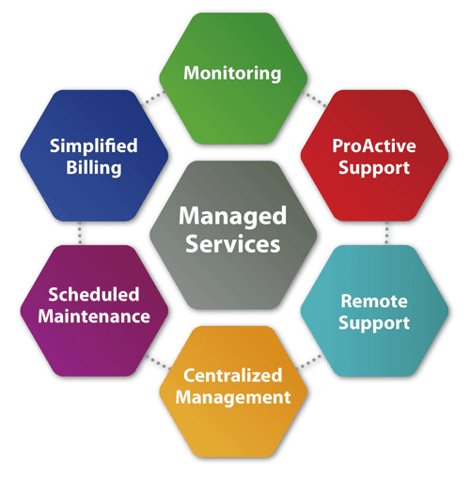
Top SAP MSPs { Examples }
Accenture
NTT Data (NDBS)
Atos
Capgemini
CDW Corporation
Cognizant
Deloitte
DXC Technologies
HCL Technologies
IBM
Infosys
LTI
PwC
Rackspace
Tata Consultancy Services
WiPro
Example of experience MSP advertised on CSP (AWS)
“NTT DATA Business Solutions AG (NDBS) is part of NTT DATA with 33 years in SAP Business in 30+ countries. As a SAP Platinum Partner and winner of countless SAP Awards, we are acknowledged as a leading SAP Partner. NDBS AG offers SAP implementations/upgrades, S/4HANA transitions and IP solutions. We migrate your SAP landscape to the AWS Cloud and manage it with our Managed Services division.“
Notes:
SAP applications are undoubtedly the core of every enterprises’ ecosystem. But managing and/or migrating them to the cloud is very challenging. That’s where an SAP managed services provider (MSP) can help. With an SAP MSP, you get various benefits such as ease of management, enhanced productivity, improved security, expert support, cost savings, etc. But you will be able to reap all these benefits only when you opt for the SAP Managed Services and go with the right SAP Managed Service Provider for your enterprise. With that being said, we bring to you some valuable tips that will help you choose the best SAP MSP for your business.

Slide 5
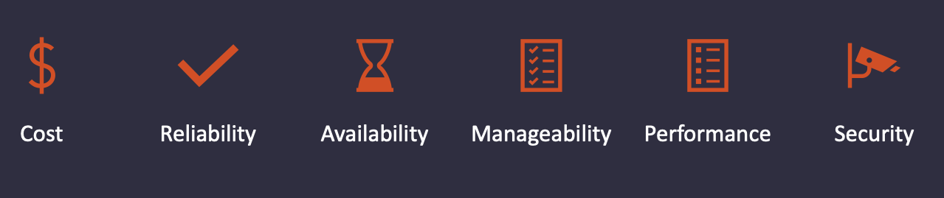
MSP Cloud infrastructure requirements:
Faster customer onboarding Choice of Hyperscalers Automation and Infrastructure as Code Consistent operational experience High Availability, DR and uptime Visibility Faster troubleshooting, threat analytics, capacity planning Transparency in billing for cost Repeatable mode, consistent operations, single automation framework | Shared Services across any cloud for secure, low latency access to any region Advance networking to simplify connectivity for unique customer needs Performance (low latency, encrypted throughput, proactive analytics) Embedded and holistic security posture to meet compliance needs
Design Pillars : CRAMPS

Slide 6











SAP S4/HANA – Aviatrix MSP Reference Design – Multi-tenant
Global Architecture Providing Unified Networking, Security, Visibility, and Control
Aviatrix Controller
Unified Management and Control
Aviatrix CoPilot Intelligent visibility and analytics
APP
WWW
T3
REGION1
REGION2
REGION3
Shared Services in any cloud
Ingress Landing Zone
Internet Egress Filtering
Multi-cloud Network Segmentation
Native Peering
Shared Services
Antivirus Patching Focused Run Monitoring DNS IPAM
Shared Services
Antivirus Patching Focused Run Monitoring DNS IPAM
Shared Services
Antivirus Patching Focused Run Monitoring DNS IPAM
PROD
Non-PROD
PROD
Non-PROD
PROD
Non-PROD
PROD
Non-PROD
PROD
T1
T1
T2
T2
T3
T3
T4
T4
T4
Aviatrix Multicloud Global Backbone for SAP
Centralized Security Services
Centralized Security Services
Centralized Security Services
High-Performance Encryption
Service Insertion
High-Performance Encryption
DX/ER/GCI
DX/ER/GCI
DX/ER/GCI
DX/ER/GCI
Customer Site (overlapping IP)
DC
Branch
DC
Branch
DC
Branch
Aviatrix Edge
Aviatrix Edge
Aviatrix Edge
T4 DC
Notes:
Shared Services:
Anti-virus ISIM Server Backup CMP Aviatrix DNS FRUN GMSDCS AD IPAM Citrix/Jumpserver Monitoring SAP Router Patch Management

Slide 7
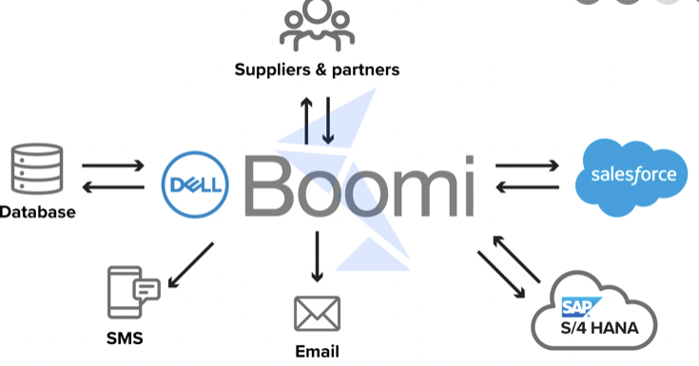
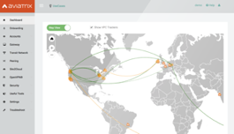
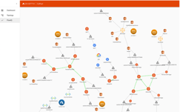







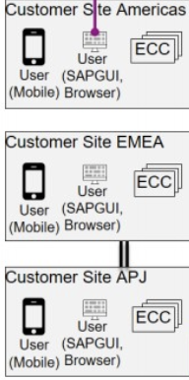

SAP HANA – Aviatrix MSP Reference Design – Single tenant
Aviatrix
Controller
Aviatrix
CoPilot
4
Global Architecture Providing Unified Security, Visibility and Control
API Integration layer
SAP extensions (Reporting, analytics)
Scenario-2 Main SAP on-prem with Pre-Prod in cloud
Scenario-1 SAP S/4 HANA customer managed in cloud
Customer business applications (reservations systems, inventory management )
Region 1
Region 2
Region 1
Region 2
Region 1
Success Factor
SaaS
Ariba SaaS
SAP App
SAP
Router
SAP App
SAP
Router
SAP App
VPC
Concur SaaS
Replication
Dev
Test
Prod
VPC
SAP HANA DB (Greenfield)
2
SAP HANA DB
SAP HANA DB
VPC
VNET
VNET
VNET
1
Aviatrix - Your Secure Cloud Network for SAP S/4 HANA
DX
DX
Master Data
EX
6
Retail stores/PoS
DC
3
Traffic flows:
Customer applications such as reservations systems writing to SAP HANA.
SAP extension apps like Ariba, Success factor accessing SAP HANA
Users accessing the SAP HANA systems from mobile, PC , handheld etc.
API integrations tools such as Boomi talking to SAP systems
Data Center hosting main SAP HANA DB and being replicated to cloud
Retail stores or PoS (Point of Sale) systems accessing SAP HANA
SAP App
SAP HANA DB (Active)
5

Slide 8
Next Steps for MSP
Cloud Network Team Tasks
Deploy Aviatrix Controller and CoPilot
Build Multicloud network backbone
Build shared services strategically in a CSP region.
Customer onboarding
Cloud Network Team Tasks
Create VPC/VNET.
Deploy Aviatrix GWs and connect SAP customer VPC/VNET on the network backbone.
SAP Team Tasks
Deploy SAP S4/HANA suite in customer’s VPC/VNET
Operations Team Tasks
Start managing and visualizing the network on the CoPilot dashboard.
Accelerating MSP customer onboarding and fast path to revenue
Skilled MSP design and implementation team to bootstrap and guide MSPs
MSP-friendly business model
The industry recognizes training programs (ACE) for Ops teams.

Slide 9



Why MSP choose Aviatrix?
 |  | Performance Patented high-performance encrypted throughput not achieved with native CSP networking constructs Aviatrix unified platform provided MSPs Ops teams a consistent set of tools to deliver end-to-end visibility and faster mean-time-to-resolution delivering higher uptimes
 |  | Agility: New SAP customers are added to a standardized, global cloud backbone across CSPs and regions Single Terraform provider to onboard new customers in plug n play mode Day2 operational tools to carry routine maintenance
 |  | Force multiplier: Aviatrix simplifies the complexity of cloud-native network constructs. It’s a unified platform intelligently managing and operationalizing deployments across multiple clouds directly addressing skill gap and talent availability

Slide 10
SAP MSP Customer Case study :
OPPORTUNITY:
MSP needed a common multi-cloud backbone upon which to standardize the onboarding of mission critical SAP S/4HANA workloads for their customers, faster.
AVIATRIX NECESSARY PLATFORM CAPABILITIES:
Consolidate shared services across clouds and regions to reduce the cost of managing multiple instances (backup, monitoring, etc.)
Relieve MSP from having to accumulate very specific CSP-knowledge specifically in AWS and Azure.
In AWS and Azure today. Look to extend in GCP in future
Regain lost control of networking functions due to the nature of multi-tenant cloud service providers
Consume Azure Network firewall in a policy driven approach (Single Vendor approach that makes contractual obligation easier)
Aviatrix Site2Cloud simplifies customers connectivity with unique networking needs
BUSINESS VALUE REALIZED WITH AVIATRIX:
MSP technologists are able to manage larger sets of mission-critical infrastructure (or more SAP customers per FTE)
MSP reduced costs for shared services (centralized and less redundancy)
No more workarounds and loopholes opening infrastructure to more cybersecurity threats

Slide 11
SAP MSP Customer Case study :
OPPORTUNITY:
MSP needed a common multi-cloud backbone upon which to standardize the onboarding of mission critical SAP s/4 HANA workloads for their customers, faster.
AVIATRIX NECESSARY PLATFORM CAPABILITIES:
Consolidate shared services across clouds and regions to reduce the cost of managing multiple instances (backup, monitoring, etc.)
Relieve MSP from having to accumulate very specific CSP-knowledge specifically in AWS and Azure.
In AWS and Azure today. Look to extend in GCP in future
Regain lost control of networking functions due to the nature of multi-tenant cloud service providers
Consume Azure Network firewall in a policy driven approach (Single Vendor approach that makes contractual obligation easier)
Aviatrix Site2Cloud simplifies customers connectivity with unique networking needs
BUSINESS VALUE REALIZED WITH AVIATRIX:
MSP technologist are able to manage larger sets of mission-critical infrastructure, each (or more SAP customers per FTE)
MSP reduced costs for shared services (centralized and less redundancy)
No more workarounds and loopholes opening infrastructure to more cybersecurity threats

Slide 13
Backup slides

Slide 14
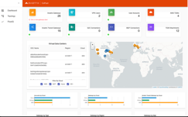
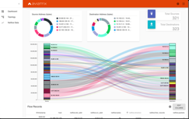







Aviatrix
CoPilot
Aviatrix
Controller
Global Architecture Providing Unified Security, Visibility and Control
VPC
VPC
VPC
VPC
VPC
VPC
VPC
VPC
VPC/ VNET
VPC/ VNET
Region 1
Region 2
Aviatrix AirSpace- Multi-hyperscaler Smart Data Plane
DX
DX
DCI / MPLS / Private Circuit
Enterprise Technical Challenges
Multi-Account
Multi-Region
High-Performance Encryption
CSP Networking Limits Repeatable Design
Network Segmentation
NGFW Service Insertion Overlapping IP Support Secure User Access Secure Ingress and Egress
Advance Hybrid and Cloud Networking Enterprise Operational Visibility
Anomaly Detection / Known Bad Actors
IDS/IPS is not part of network
Alert and Monitoring
Notes:
Break down slide in pillars
Build it gradually
1- Security 2- Operations 3- Visibility
4- Application pillar – talk about SAP / Kubernetes / etc.

Slide 15
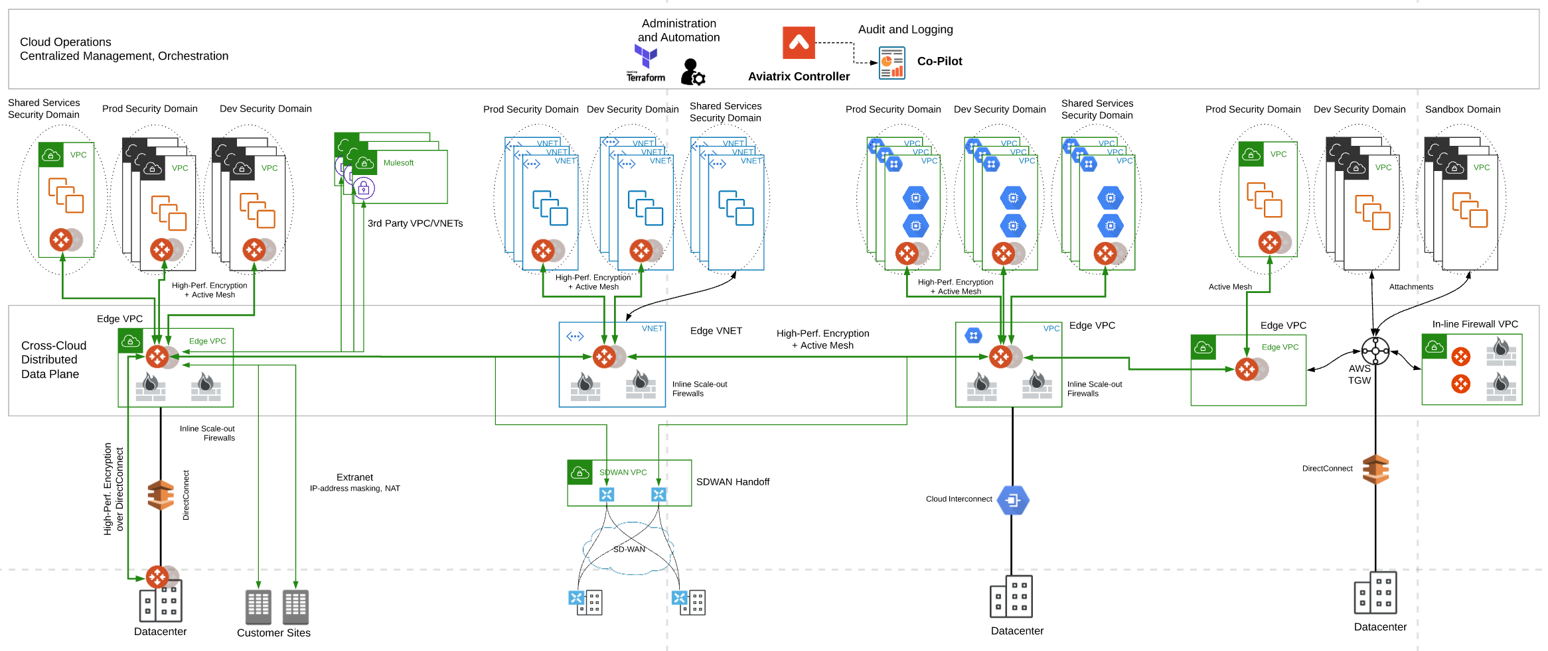
Successful Cloud Network Architecture for Enterprises

Slide 16


SAP HANA – Aviatrix MSP Reference Design – Multi-tenant
Intelligent visibility and analytics
Aviatrix
Controller
Aviatrix
CoPilot
Global Architecture Providing Unified Security, Visibility and Control
API Integration layer
Internet
APP
C50 DC
AMERICAS
EUROPE
C4
APAC
Shared services in any cloud
Ingress Landing Zone
Multi-cloud Network segmentation
Native Peering
DX
Shared Service
Antivirus
Patching
SAP router
FRUN
Monitoring
DNS
IPAM
Shared Service
Antivirus
Patching
SAP router
FRUN
Monitoring
DNS
IPAM
Egress filtering
Shared Service
Antivirus
Patching
SAP router
FRUN
Monitoring
DNS
IPAM
PROD
Non-PROD
PROD
Non-PROD
PROD
Non-PROD
PROD
Non-PROD
PROD
Non-PROD
PROD
Non-PROD
C1
C1
C2
C2
C3
C3
C4
C4
C49
C49
C50
C50
Aviatrix Global Multi-Hyperscaler Backbone for SAP
Centralized Security Services
Centralized Security Services
Centralized Security Services
Service Insertion
High performance encrypted connection
Customer site connection (overlapping ip
DX
ER
GCI
Aviatrix Edge Connectivity
DC
EDGE
DC
EDGE
DC
EDGE
Notes:
Shared Services:
Anti-virus ISIM Server Backup CMP Aviatrix DNS FRUN GMSDCS AD IPAM Citrix/Jumpserver Monitoring SAP Router Patch Management

